Slide 1
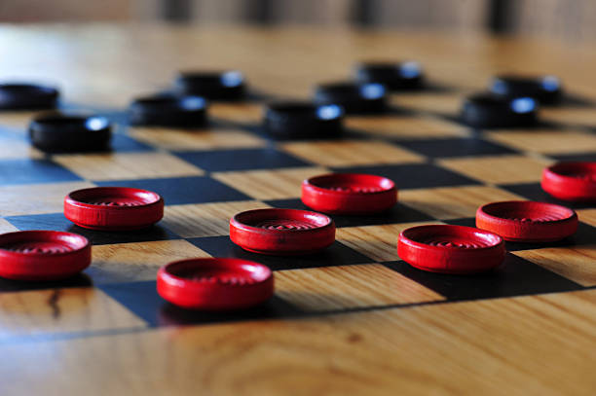
Checkers
Course Project for CSCI 352
Connor Walsh, Daniel Cunningham

Slide 2
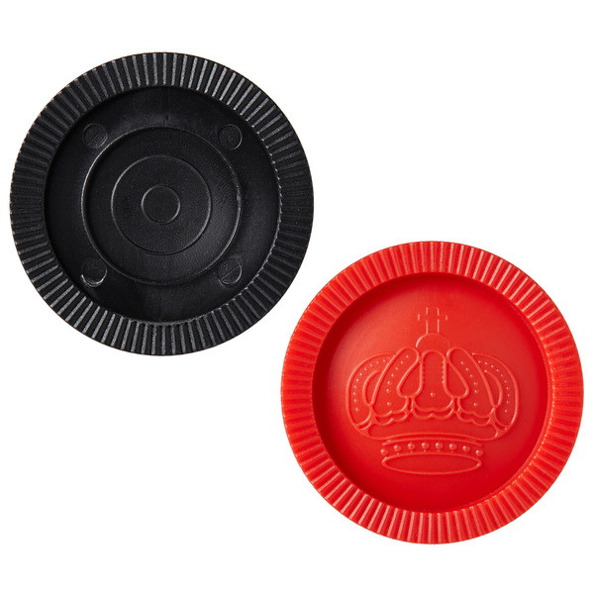
Background
This project is a two-player checkers game that can be played offline
The project enforces the rules of an actual game of checkers
The project features some customization options
We chose to create a checkers program because we wanted to adapt a board game using WPF
We originally wanted to adapt chess, but switched to checkers
This project is for people who are already familiar with checkers, but it could also be used by people who are not since the game enforces the rules.

Slide 3
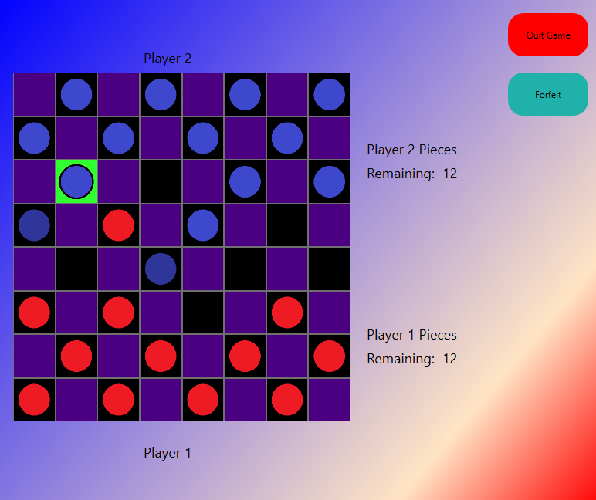
Approach
We made the checkerboard out of a grid and buttons.
The checker pieces are png image files with transparent backgrounds that we made online.
All of the windows in our program use the LinearGradientBrush class that is built into C#.
We did not use any special libraries or drivers.
We used the factory design pattern to allow for the user to change the color of the squares
We used the decorator pattern to change the pieces to kings once they reach the other side of the board.
Whenever a piece reaches the other side of the board, a KingDecorator is made and put as a component to the piece that needs to be promoted.

Slide 4
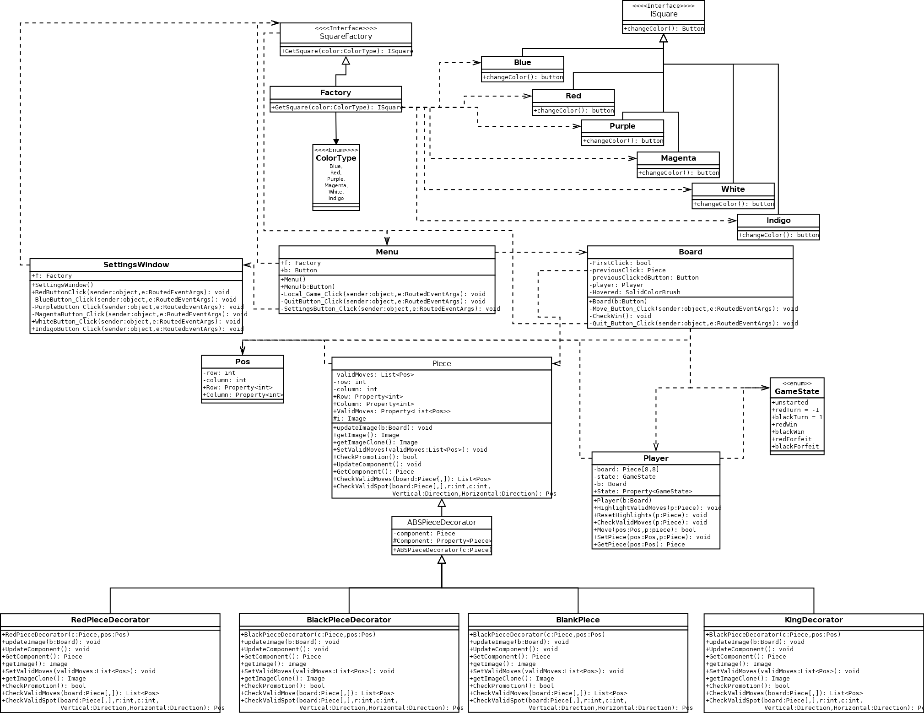
Class Diagram UML
This is the UML for the entire project.
On the top, the Factory can be seen and the decorator can be seen at the bottom.
The middle of the UML shows the different windows in the program and how they interact with the other class files.

Slide 5
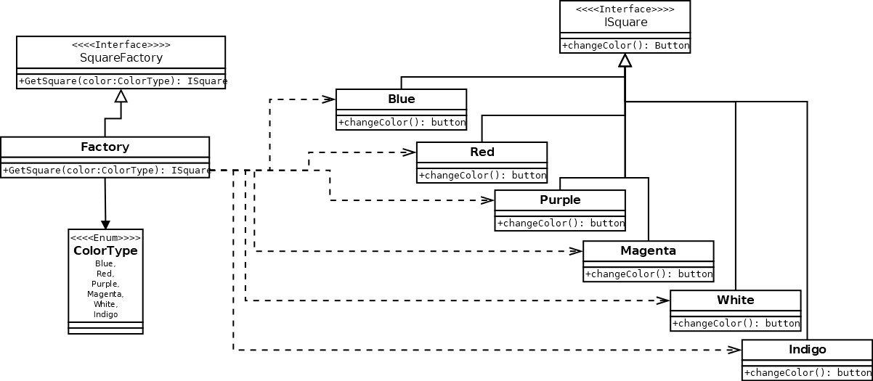
Class Diagrams: Factory Pattern UML
This UML shows how the factory pattern works.
There is a SquareFactory interface that the Factory inherits from and then the GetSquare method uses enumeration to select and return the different colors of squares.
The square classes inherit from the ISquare Interface.

Slide 6
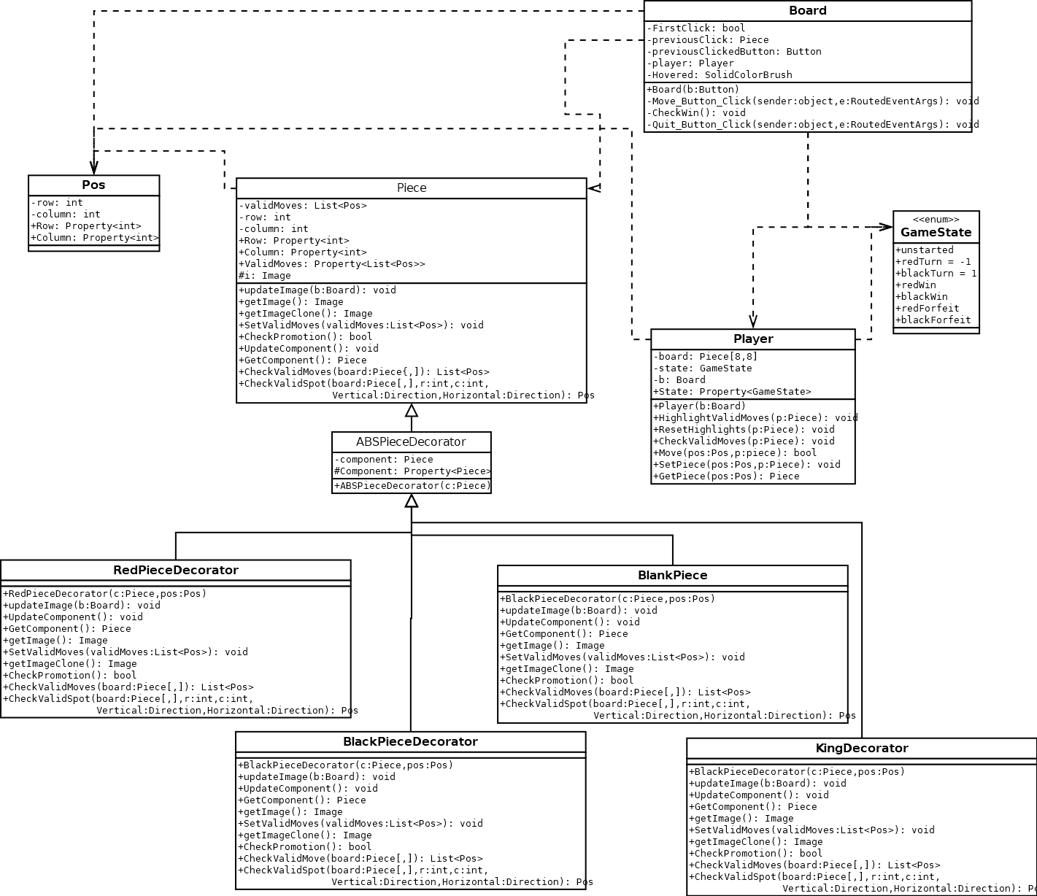
Class Diagrams: Decorator UML
There are four decorators:
RedPieceDecorator
BluePieceDecorator
BlankPiece
KingPieceDecorator
Whenever a piece is about to be moved, the program checks the valid moves of the pieces, using the correct decorator method.
In each decorator CheckValidMoves method, the program checks the component and if the component is not null, the program uses the component’s methods.
After checking the moves, the moves are displayed to the player through piece highlighting.
Once the user picks a move, the player object either takes the pieces or swaps the blank space with the correct decorator.

Slide 7
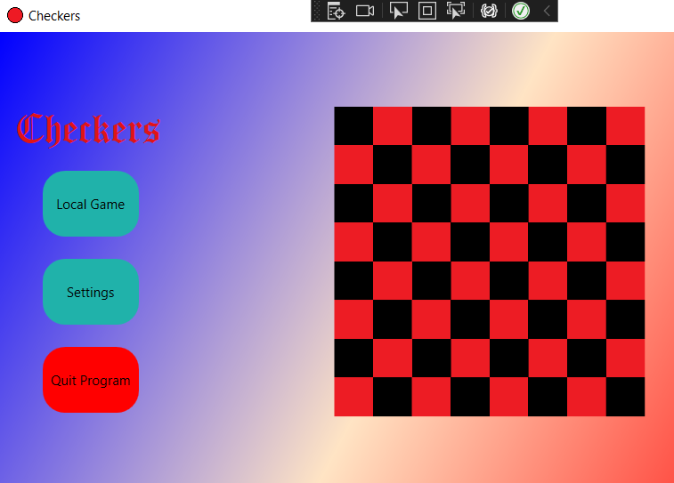
Checkers Game Demo
In order to begin the checkers game, click “Local Game” at the main menu of the program.
The red pieces move first.
If a user wants the board color to be changed, they can select a color from the settings window at the main menu.

Slide 8
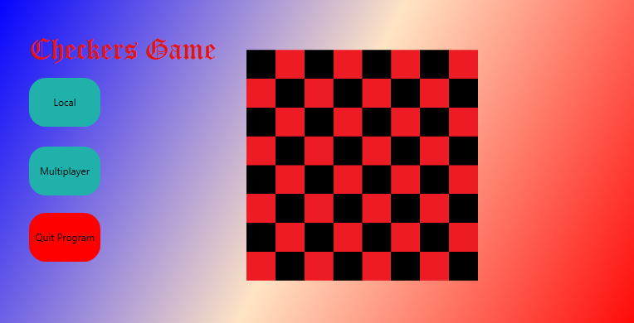
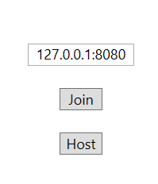
Future Work
We were unable to get the multiplayer feature in the program working so we might finish this feature and add it to the project at a later date.
We also made it a stretch goal to be able to save and load a game, so we may also implement this feature at some point in the future.

Slide 9
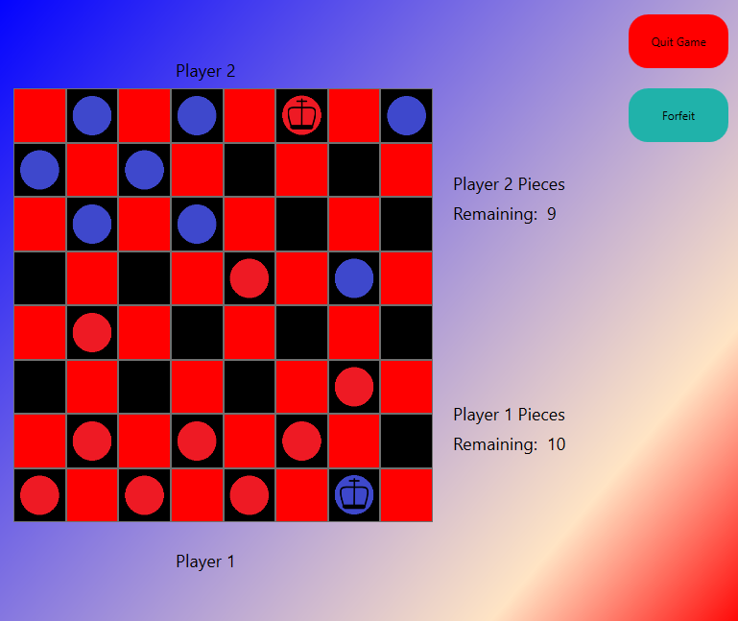
Questions?
cwalsh24@ut.utm.edu
danrcunn@ut.utm.edu
Connor’s Repo:
https://github.com/cwalsh24
Daniel’s Repo: https://github.com/Daniel-Cunningham02

